Slide 1
Software Engineering
Module No. 1
An Overview of Software Engineering

Slide 2
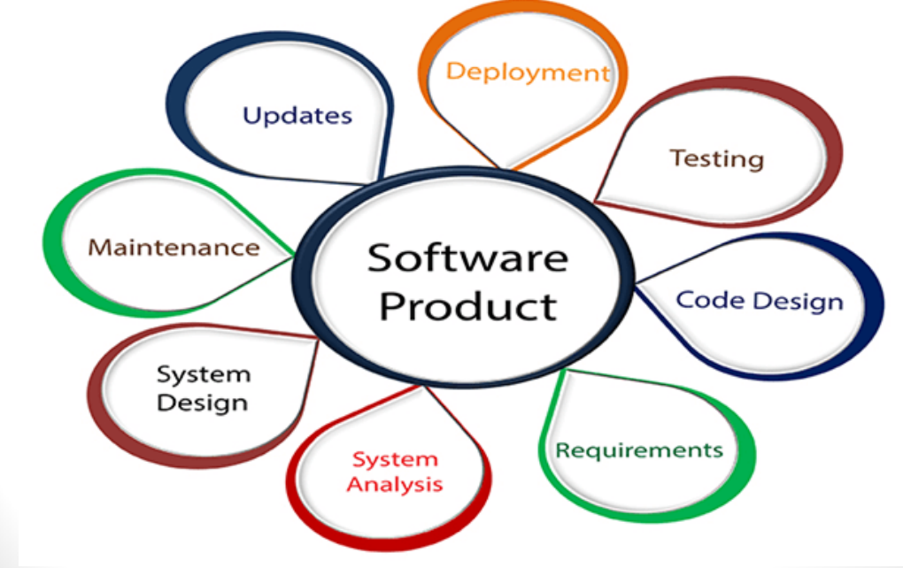
What is Software Engineering?

Slide 3
What is Software Engineering?
The term software engineering is the product of two words, software, and engineering.
Software, when made for a specific requirement is called a software product.
Engineering, on the other hand, is all about developing products, using well-defined, scientific principles and methods.

Slide 4
Software
Software is:
Instructions (computer programs) that when executed provide desired features, function, and performance;
Data structures that enable the programs to adequately manipulate information and,
Documentation that describes the operation and use of the programs.
Software is a logical rather than a physical system element

Slide 5
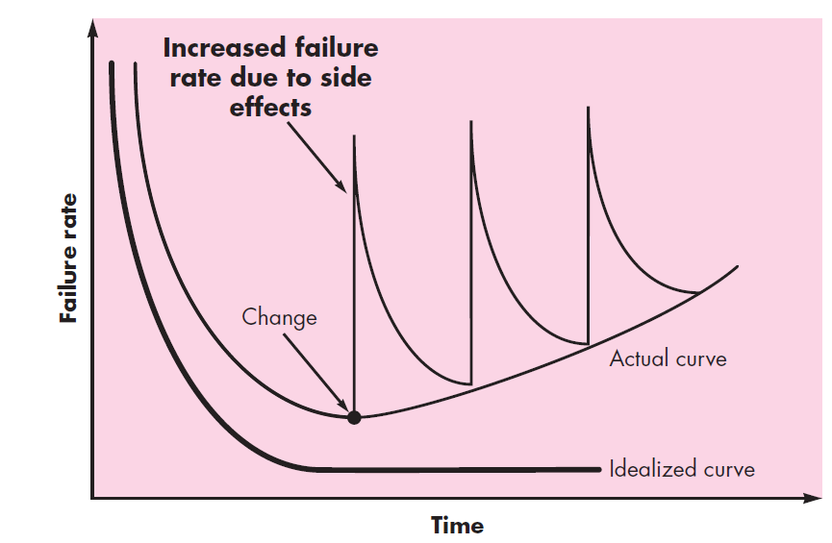
Characteristics of Software
Software is developed or engineered; it is not manufactured in the classical sense.
Software doesn’t “wear out.”
Although the industry is moving toward component-based construction, most software continues to be custom built.

Slide 6
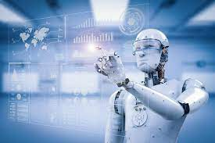



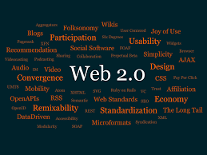
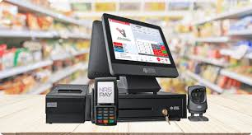
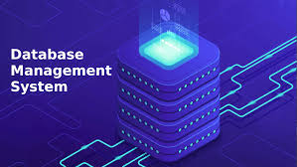
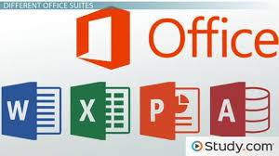
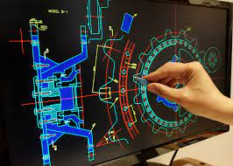
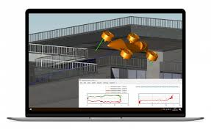
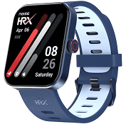
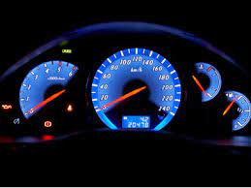
Software Application Domains
Artificial intelligence software
System Software
Web Applications
Software Application Domains
Application Software
Product-line software
Point-of-sale transaction processing
Engineering
/scientific software
Embedded software
Computer-Aided Design
System Simulation

Slide 7
Software—New Categories
Open world computing—Pervasive, Distributed computing
Ubiquitous computing—Wireless networks
Netsourcing—the Web as a computing engine
Open source—”free” source code open to the computing community (a blessing, but also a potential curse!)
Also …
Data mining
Grid computing
Cognitive machines
Software for nanotechnologies

Slide 8
Legacy Software
A legacy system is outdated computing software and/or hardware that is still in use.
Why must it change?
Software must be adapted to meet the needs of new computing environments or technology.
Software must be enhanced to implement new business requirements.
Software must be extended to make it interoperable with other more modern systems or databases.
Software must be re-architected to make it viable within a network environment.

Slide 9
Characteristics of WebApps
Network intensiveness. A WebApp resides on a network and must serve the needs of a diverse community of clients.
Concurrency. A large number of users may access the WebApp at one time.
Unpredictable load. The number of users of the WebApp may vary by orders of magnitude from day to day.
Performance. If a WebApp user must wait too long (for access, for server-side processing, for client-side formatting and display), he or she may decide to go elsewhere.
Availability. Although expectation of 100 percent availability is unreasonable, users of popular WebApps often demand access on a “24/7/365” basis.

Slide 10
Characteristics of WebApps
Data driven. The primary function of many WebApps is to use hypermedia to present text, graphics, audio, and video content to the end-user.
Content sensitive. The quality and aesthetic nature of content remains an important determinant of the quality of a WebApp.
Continuous evolution. Unlike conventional application software that evolves over a series of planned, chronologically-spaced releases, Web applications evolve continuously.
Immediacy. Although immediacy—the compelling need to get software to market quickly—is a characteristic of many application domains, WebApps often exhibit a time to market that can be a matter of a few days or weeks.
Security. Because WebApps are available via network access, it is difficult, if not impossible, to limit the population of end-users who may access the application.
Aesthetics. An undeniable part of the appeal of a WebApp is its look and feel.

Slide 11
Characteristics of good software
A software product can be judged by what it offers and how well it can be used.
This software must satisfy on the following grounds:
Operational
Transitional
Maintenance

Slide 12
Some Realities about Software
A concerted effort should be made to understand the problem before a software solution is developed.
Design becomes a pivotal activity.
Software should exhibit high quality.
Software should be maintainable.
Software in all of its forms and across all of its application domains should be engineered

Slide 13
Software Engineering
Software Engineering is an engineering branch related to the evolution of software product using well-defined scientific principles, techniques, and procedures. The result of software engineering is an effective and reliable software product.
The IEEE(Institute of Electrical and Electronics Engineers) definition:
Software Engineering: (1) The application of a systematic, disciplined, quantifiable approach to the development, operation, and maintenance of software; that is, the application of engineering to software. (2) The study of approaches as in (1).

Slide 14
Why is Software Engineering required
To manage Large software
For more Scalability
Cost Management
To manage the dynamic nature of software
For better quality Management

Slide 15
Software Engineering Layers
Tools
Methods
Process Model
A “quality” focus
The foundation for software engineering is the process layer.
Software engineering methods provide the technical how-to’s for building software.

Slide 16
Importance of Software Engineering
Effectiveness
To minimize Software Cost
Importance of Software Engineering
Handling Large Projects
Reduce the time Effort
Reduces complexity
Reliable Software

